Slide 1
Manager’s Meeting 2024
Welcome!

Slide 2
Thank you to our sponsors!
2024

Slide 3
STLWEST Manager
Presentation Agenda
1 | Association & League Overview
2 | Ranking, Scheduling/Rescheduling
3 | Fields
4 | Rules
5 | Important Dates and Events

Slide 4
2024 is STLWEST’s 12th Year!

Slide 5
2024 STLWEST Board Members, STLWEST Park Personnel

Slide 6
STLWEST Executive Board Members
President – Keith Ellis (PAA)
Vice President – Luke Holman (ESA)
Secretary – Patrick Murphy (BAA)
Treasurer – Dan Flaschar (EAA)
Baseball Coordinator – Mark Maier (BAA)
Softball Coordinator – Dionna Helfers (PAA)

Slide 7
STLWEST General Board Members
Jason Neal (BAA)
Ted Repp (BAA)
Bill Anderson (EAA)
Dionna Helfers (PAA)
Sheri O’Brien (VPAA)

Slide 8
STLWEST Ballpark Presidents
Patrick Murphy (BAA)
Matt Cleve (EAA)
Bob Kraemer (PAA)
John O’Brien (VPAA)

Slide 9
STLWEST Umpire in Chiefs (UIC)
Jason Neal (BAA)
Alan Manetzke (EAA)
Luke Hollman (Eureka)
Mike Miller (PAA)
Gerald Pfeiffer (VPAA)

Slide 10
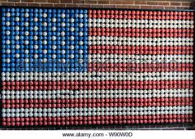
STLWEST League Levels
Blue – Competitive (AA and up)
Red – Semi competitive (A)
White - Recreation

Slide 11
STLWEST League Ranking Process
Our Goal: Each league consists of teams playing at the same level
The three division levels is just the starting point
Strive to have 5-7 teams per league this year
Teams are ranked by the following ways:
Manager submits STLWEST Ranking Form (due 2/3)
Age Group Coordinators and Commissioners
Previous results
League Setup

Slide 12
STLWEST League Ranking Process
For 2024, we will continue to include teams to review their respective rankings prior to creating schedules.
For larger age groups, we may conduct meetings with age group coordinators, as well as invite managers, to assure best setup for league.

Slide 13
Ranking 8U Teams
Consider these things while selecting a ranking
Blue (AA) – Hard hit balls through the lineup, team is athletic and have good middle infield and outfield play.
Red (A) – Hard hit balls through half the lineup, team consists mostly of good athletes with average infield play.
White (Rec) – Minimal hard-hit balls, teams are mix of pool players and friends. Most players are still learning to play and building a basic skill set.

Slide 14
STLWEST League Scheduling
Block Out Dates
Up to 8 dates
Due no later than February 15
Schedules received by March 3

Slide 15
STLWEST Schedule Conflict Meeting
March 9 – Location West Springs Church
Softball Age Group | Time
7U
8U
10U
12U
14U
Baseball Age Group | Time
7U (EAA/Eureka/PAA)
8U
9U
10U
11U
12U
13U
14U

Slide 16
Rescheduling after March 9
Section 3.06 A manager may request a game be rescheduled under the following conditions:
If requested prior to 10 days before the originally scheduled game then can be changed at no fee,
If requested within 10 days before the originally scheduled game then can be changed at a fee as determined by the home association,
NO game shall be rescheduled within 72 hours of originally scheduled game time

Slide 17
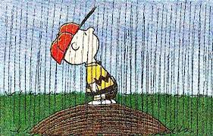
Rescheduling Due to Inclement Weather
Section 5.24 The home team must contact by email the visitor within 7 days of the rainout and offer two dates. The visiting team must respond within nine (9) days of the rainout to the two (2) dates offered. Even with conflicts the game must be rescheduled within fourteen (14) days of the rainout. That does not mean played within fourteen (14) days just rescheduled for a later date. If neither team initiates a reschedule within the fourteen (14) day time frame, the game will go down as FORFEIT for both teams.

Slide 18
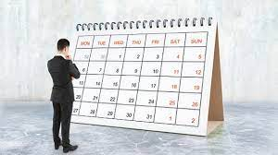
Rescheduling Due to Inclement Weather
Section 5.25 If one team is at fault for the game not being re-scheduled in the two (2) week period, that team will receive the forfeit. This will be determined by email dates and times. A forfeit shall be recorded with a score of 7-0.

Slide 19
STLWEST HEAT/COLD POLICY
Section 5.22 (a) STLWEST games will be canceled/delayed if the heat index exceeds 105° F or if the temperature is below 40°F 1 hour prior to the start of the game at the park where the game is to be played. Games can be delayed up to 30 min. if delaying the start of the game would possibly meet the policy standard. The official weather source that will be used at each park will be the AccuWeather App.

Slide 20
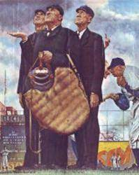
Rainout Line Phone Numbers
(please save on your mobile phones)
BAA 636-229-1110
EAA 636-821-1656
Eureka 636-496-0030
PAA 636-458-9627
VPAA 636-923-8852

Slide 21
Park Rules
Please leave outside food/drink at home. All parks have great concession stands.
Please leave your pets at home.
Also, no skateboarding or bikes in the park.
Smoking in designated areas only.
Please pass information on to your parents.
Eureka is public park. Some of these rules may not apply at Eureka only.

Slide 22
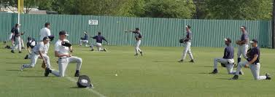
Help Maintain Your Fields
Soft toss on outfield grass is not permitted. Never hit balls into fencing.
Please keep players off the infield/outfield foul lines.
For pregame infield, hit from 3rd to 2nd or 1st to 2nd
Keep off any grass areas on the infield
No batting practice on the field is permitted prior to the game.
Do not warm up pitchers prior to the game on field mound

Slide 23
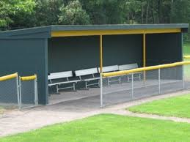
Before and After Games
See something, say something
If you notice an issue with field equipment or conditions, please alert the UIC or board member for immediate attention.
Please clean up your dugout and vacate following your game.
Talk to your team off the field

Slide 24
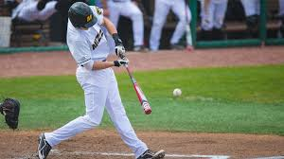
STLWEST Bat Rules (Baseball)
BPF 1.15 stamp (USSSA)
USA Baseball, BBCOR,
and wood bats are allowed
No drop rules
The maximum diameter is two and three quarters inches (2 3/4") and the maximum length is thirty-six inches (36").
Baseball bats only for baseball. No Softball, T-Ball or “coach pitch” bats.

Slide 25
STLWEST Bat Rules (Softball)
All bats must bear the USA/ASA/NSA/USSSA approved certification mark.
The maximum diameter is two and one quarter inch (2 1/4") and the maximum length is thirty-four inches (34"). Max weight is thirty-eight ounces (38oz).
Softball bats only for Softball. No Baseball, T-Ball or “coach pitch” bats.

Slide 26
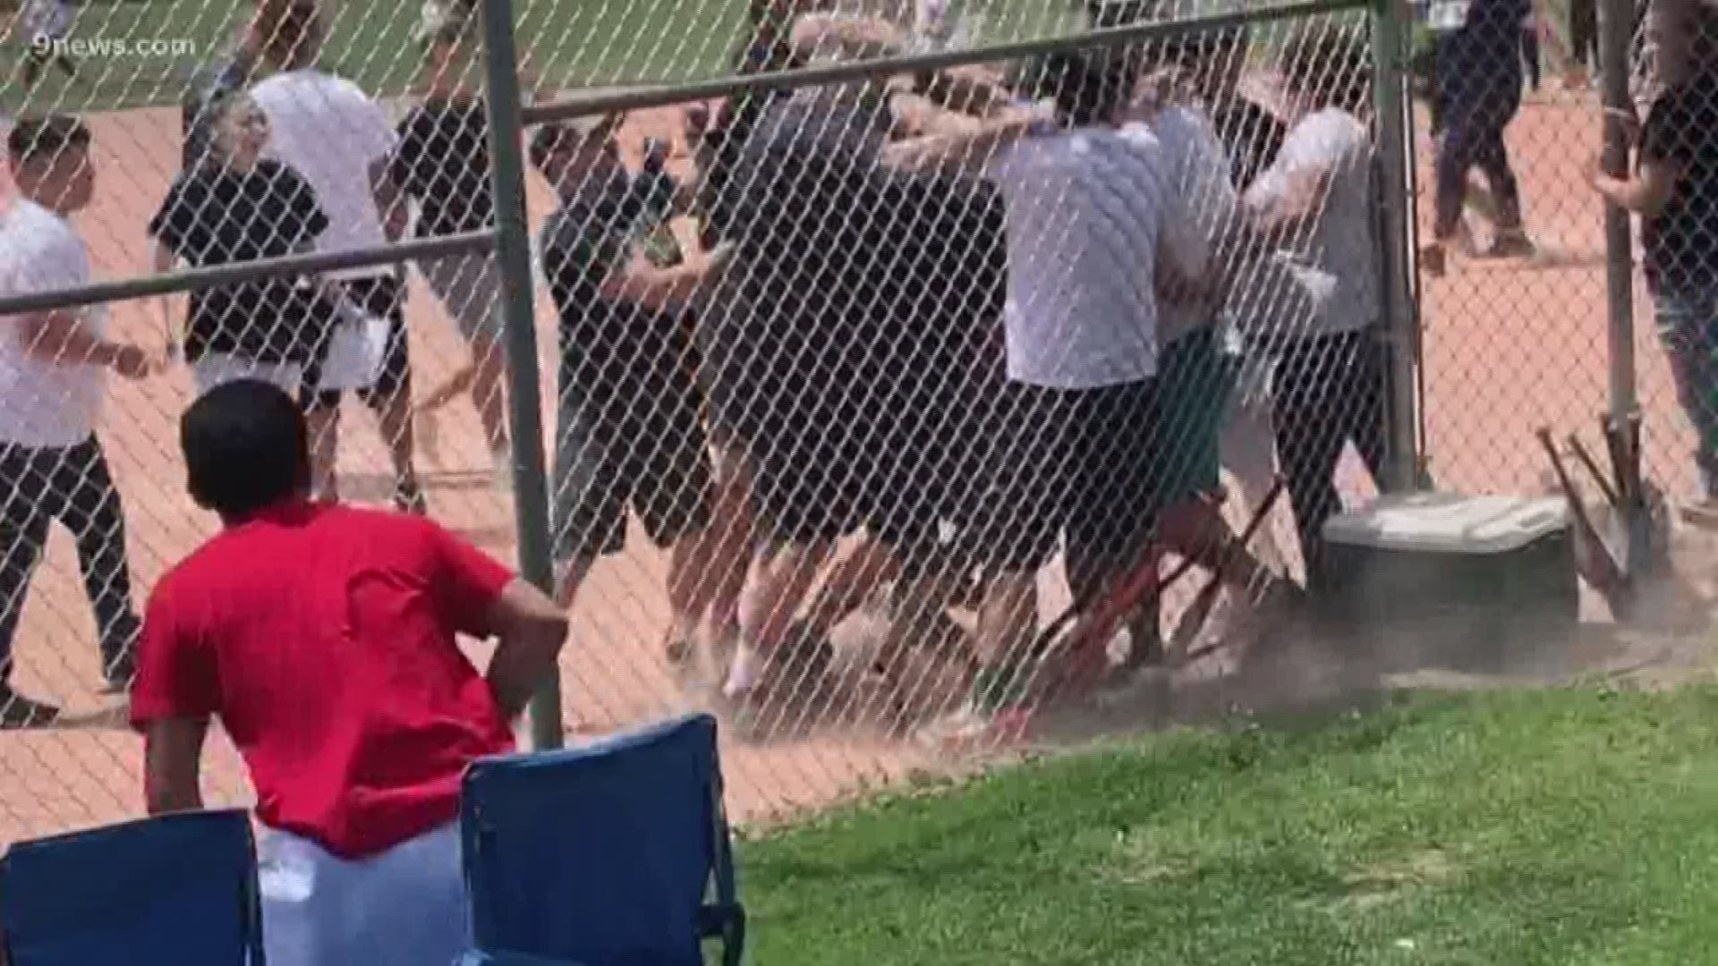
It is Your Responsibility
Managers are solely responsible for their coaches, players, parents and fans.
Hostility between teams, coaches, players, parents, or fans is strictly prohibited
Notes:
Umpire treatment and training
Your son or daughter may be and umpire someday. How would you like them to be treated?

Slide 27
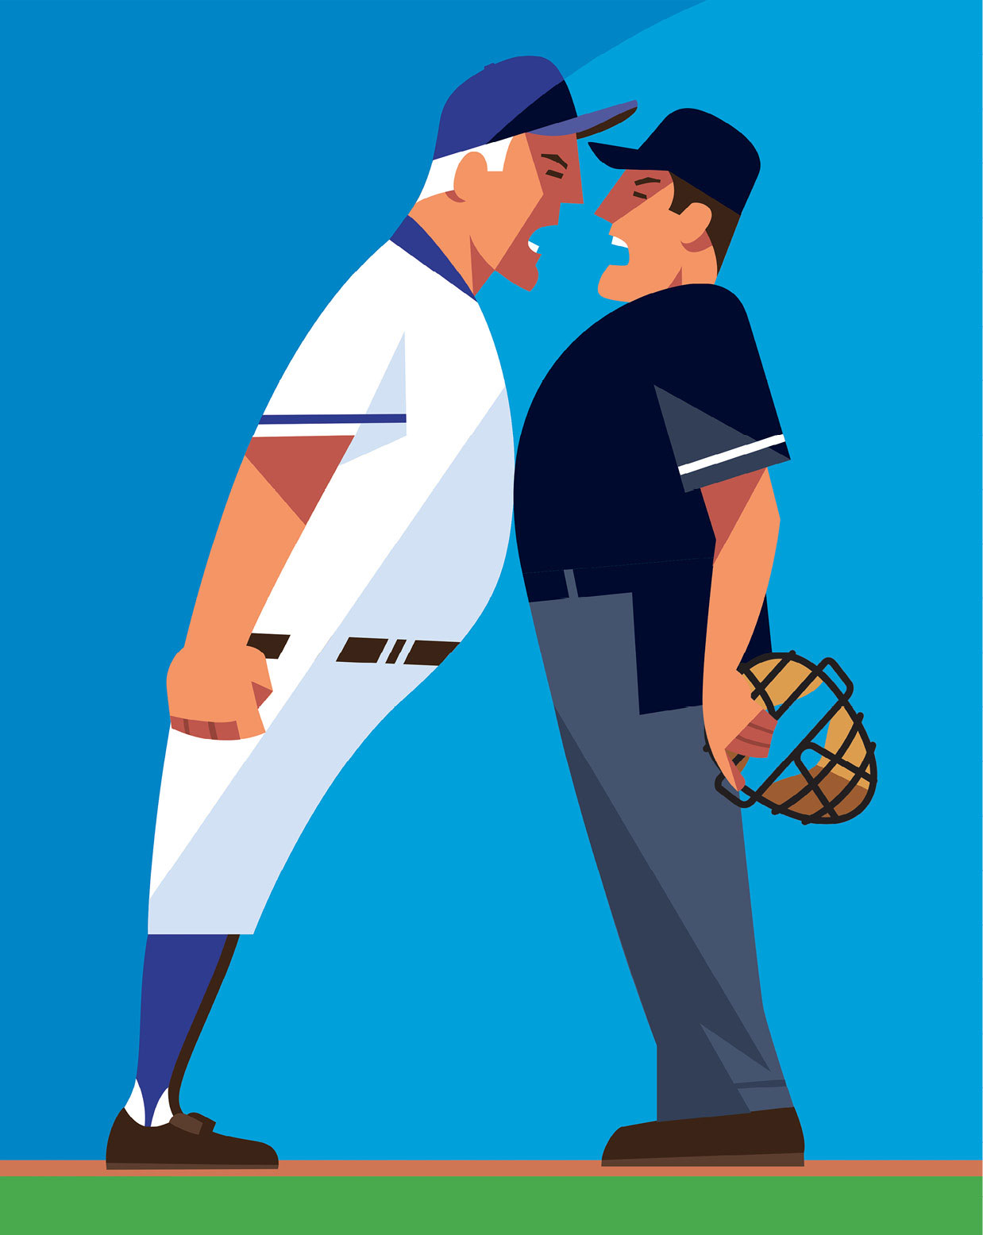
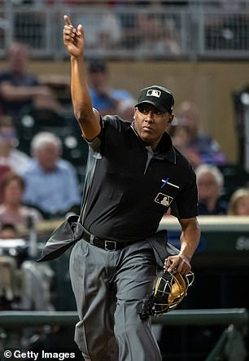
Unacceptable Actions/Behavior Towards Umpires
Constant badgering or yelling
Intimidating or threatening
Vulgar language
Physical contact
Any ejection results in an automatic
one game suspension

Slide 28
New STLWEST Rules for 2024
Mercy rule for baseball 9u-high school will be 10 runs after 4 innings in a 7-inning game (Page 15)
Metal spikes are prohibited on all turf fields (Page 16)
In all pitching machine games, if the ball hits the machine or coach feeding machine, ball becomes dead and runners advance only if forced (Pages 18, 19, 23, & 24)

Slide 29
New STLWEST Rules for 2024
9u baseball WHITE LEVEL ONLY: No walks. If the ball is not put in play after 4 balls, batter receives 2 coach-pitches. (Page 20)
FALL BALL BASEBALL: 8u-high school time limit will be 1 hour 40 minutes finish the batter. (Page 21)
10u softball WHITE LEVEL ONLY: No walks. If the ball is not put in play after 4 balls, batter receives 2 coach-pitches. (Page 26)

Slide 30
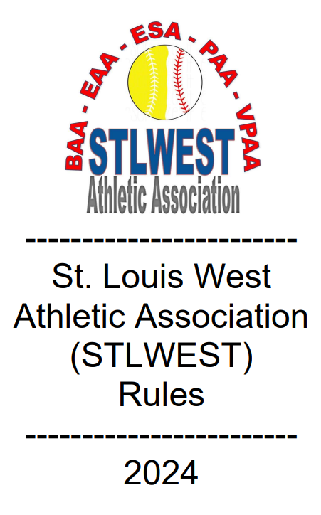
2024 STLWEST Rule Book
Each park website will have a link to the 2024 rulebook for the entirety of the season.
www.baapark.org >> Quick Links
www.eaapark.net >> Quick Links
www.pondathletic.com >> Main Page
www.eurekasports.com >> Quick Links
www.vpaapark.com >> Helpful Links

Slide 31
STLWEST Important Dates
Date | Event
February 3 | Ranking forms due from managers
February 15 | Last day to enter block out dates (8)
March 10 | Last day to register for preseason tournament
March 9 | Scheduling conflict meeting at West Springs Church
April 1 - April 8 | STLWEST Preseason Tournament
April 10 – July 21 | STLWEST Season

Slide 32
STLWEST Glen Herbst Memorial Preseason Tournament
April 1-8
April 9 rainout date for championship games
3-game minimum
Cost: $350
Schedules provided no later than March 24
Last Chance to Register is March 10
Register online on your home park’s website

Slide 33
Pond Athletic Association Hosts
MLB Pitch, Hit and Run
Date/Time TBD
Event sponsored by MLB
Go to www.pondathletic.com for more information.

Slide 34
Pond Athletic Association
7up Tournament
Dates TBD
7UP annual tournament is for 7U and 8U teams.
More information coming soon on Pond’s website

Slide 35
Ballwin Athletic Association
Stars and Stripes Blast Baseball Tournament
June 20 - 23
Rec/A Divisions
3-game minimum – 2 pool/single elimination format
Cost: 8U; $350, 9U-14U; $450, HS - $550
www.baapark.org to register/more information

Slide 36
Ballwin Athletic Association
Middle School Summer Classic Baseball Tournament
All teams consist of players that will attend same high school
July 22 – July 29
4-game minimum – 3 pool/single elimination format
12u – 14u Baseball Cost: $550
www.baapark.org to register/more information

Slide 37
STLWEST All Star Events
For EAA, Eureka, PAA Teams:
Tuesday, June 25
For BAA Teams:
Saturday, August 10 – Sunday, August 11

Slide 38
Join your Association’s Board!
STLWEST consists of parks run by volunteers
Positive impact on our community
Plugged into baseball/softball scene and help keep our leagues consistent with local and national trends.

Slide 39
STLWEST Ballpark Presidents
--Patrick Murphy (BAA) pjmurphy80@yahoo.com
--Matt Cleve(EAA)
President@eaapark.net
--Bob Kraemer (PAA) bobkraemer@charter.net
--John O’Brien (VPAA) johno@aaatrl.com

Slide 40
If you have any questions, please contact your home association’s commissioner. We wish you all a great 2024!
Thank you!

